Slide 1
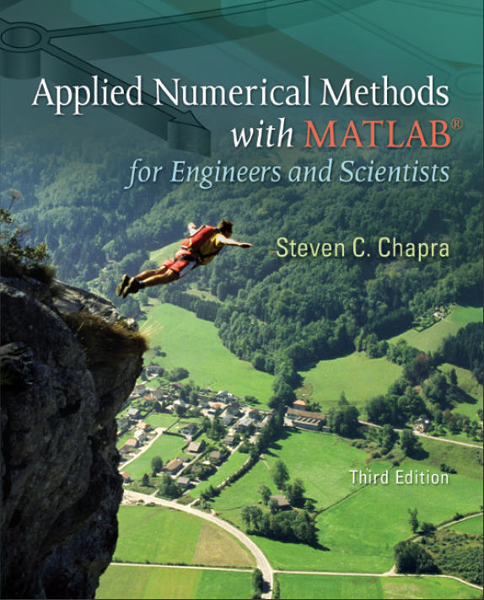
Part 2
Chapter 6
Roots: Open Methods
PowerPoints organized by Dr. Michael R. Gustafson II, Duke University
All images copyright © The McGraw-Hill Companies, Inc. Permission required for reproduction or display.

Slide 2
Chapter Objectives
Recognizing the difference between bracketing and open methods for root location.
Understanding the fixed-point iteration method and how you can evaluate its convergence characteristics.
Knowing how to solve a roots problem with the Newton-Raphson method and appreciating the concept of quadratic convergence.
Knowing how to implement both the secant and the modified secant methods.
Knowing how to use MATLAB’s fzero function to estimate roots.
Learning how to manipulate and determine the roots of polynomials with MATLAB.

Slide 3
Open Methods
Open methods differ from bracketing methods, in that open methods require only a single starting value or two starting values that do not necessarily bracket a root.
Open methods may diverge as the computation progresses, but when they do converge, they usually do so much faster than bracketing methods.

Slide 4
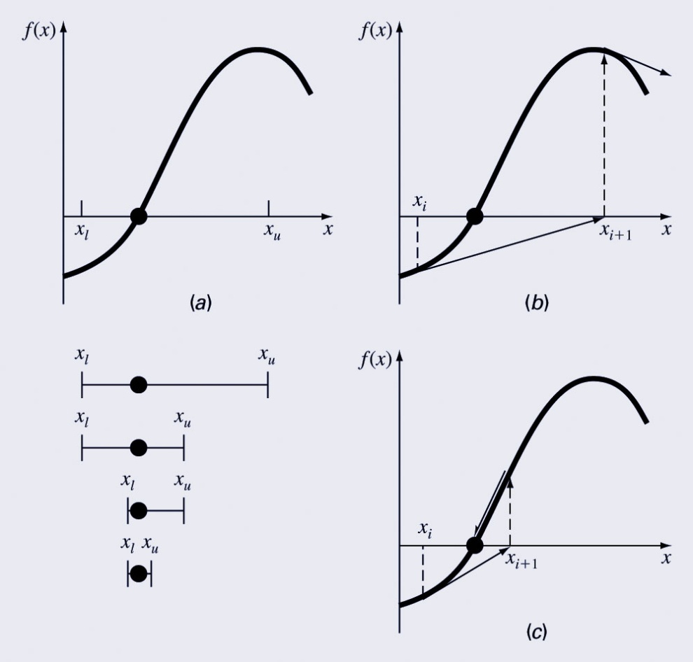
Graphical Comparison of Methods
Bracketing method
Diverging open method
Converging open method - note speed!

Slide 5
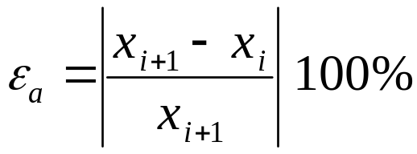
Simple Fixed-Point Iteration
Rearrange the function f(x)=0 so that x is on the left-hand side of the equation: x=g(x)
Use the new function g to predict a new value of x - that is, x_{i+1}=g(x_{i})
The approximate error is given by:

Slide 6
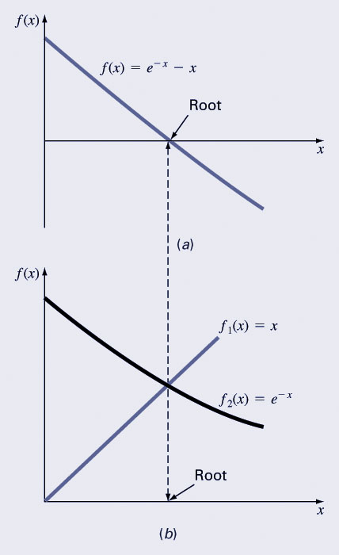
Example
Solve f(x)=e^{-x}-x
Re-write as x=g(x) by isolating x
(example: x=e^{-x})
Start with an initial guess (here, 0)
Continue until some tolerance
is reached
i | x_{i} | |ε_{a}| % | |ε_{t}| % | |ε_{t}|_{i}/|ε_{t}|_{i-1}
0 | 0.0000 |  | 100.000
1 | 1.0000 | 100.000 | 76.322 | 0.763
2 | 0.3679 | 171.828 | 35.135 | 0.460
3 | 0.6922 | 46.854 | 22.050 | 0.628
4 | 0.5005 | 38.309 | 11.755 | 0.533

Slide 7
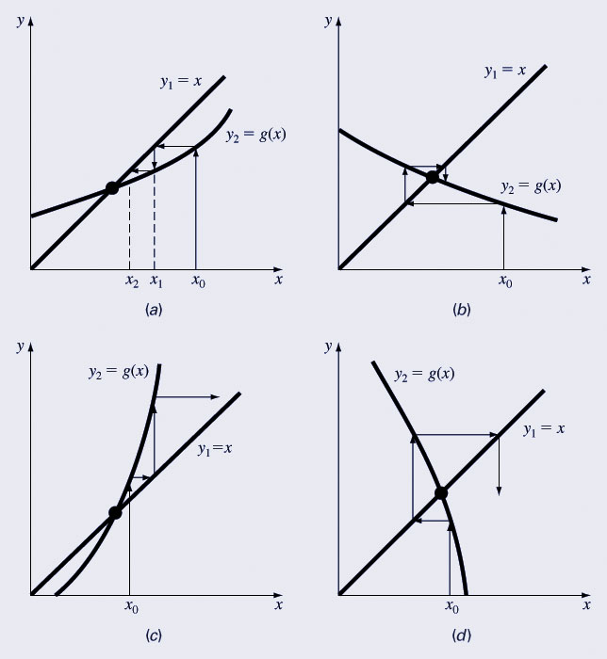
Convergence
Convergence of the simple fixed-point iteration method requires that the derivative of g(x) near the root has a magnitude less than 1.
  Convergent, 0≤g’<1
  Convergent, -1<g’≤0
  Divergent, g’>1
  Divergent, g’<-1

Slide 8
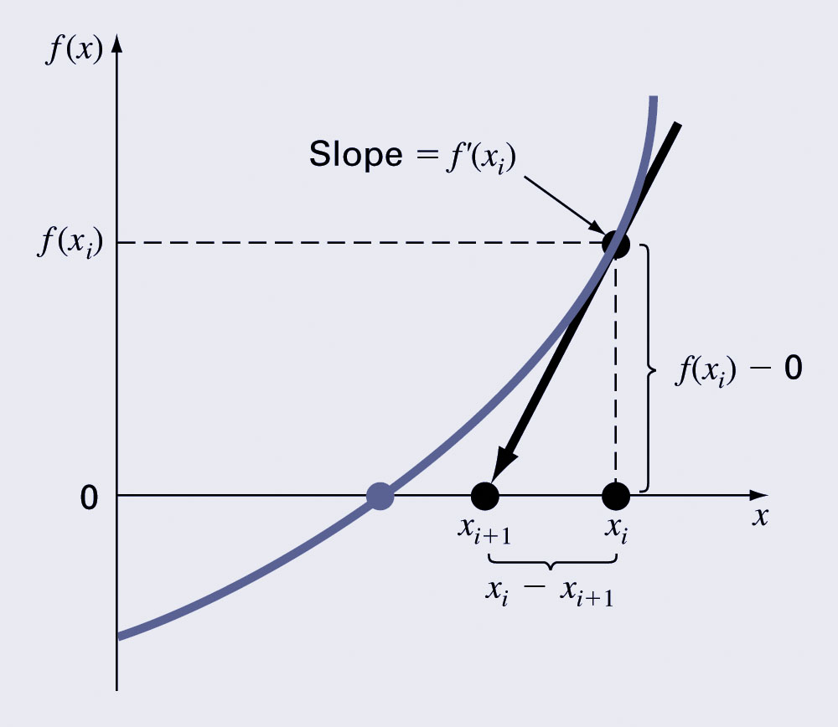
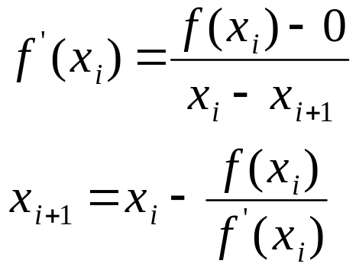
Newton-Raphson Method
Based on forming the tangent line to the f(x) curve at some guess x, then following the tangent line to where it crosses the x-axis.

Slide 9
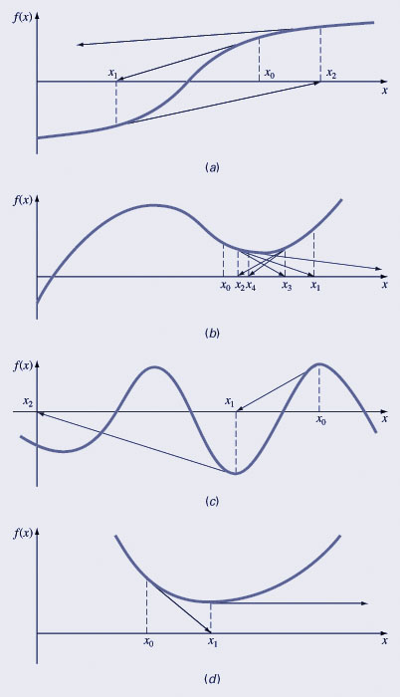
Pros and Cons
Pro: The error of the i+1th iteration is roughly proportional to the square of the error of the i^{th} iteration - this is called quadratic convergence
Con: Some functions show slow or poor convergence

Slide 10
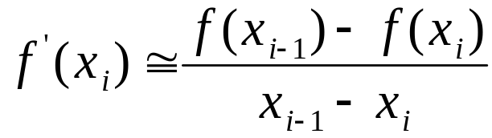
Secant Methods
A potential problem in implementing the Newton-Raphson method is the evaluation of the derivative - there are certain functions whose derivatives may be difficult or inconvenient to evaluate.
For these cases, the derivative can be approximated by a backward finite divided difference:

Slide 11
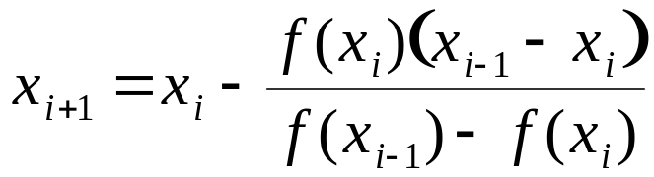
Secant Methods (cont)
Substitution of this approximation for the derivative to the Newton-Raphson method equation gives:
Note - this method requires two initial estimates of x but does not require an analytical expression of the derivative.

Slide 12
MATLAB’s fzero Function
MATLAB’s fzero provides the best qualities of both bracketing methods and open methods.
  Using an initial guess:
  x = fzero(function, x0)
  [x, fx] = fzero(function, x0)
    function is a function handle to the function being evaluated
    x0 is the initial guess
    x is the location of the root
    fx is the function evaluated at that root
  Using an initial bracket:
  x = fzero(function, [x0 x1])
  [x, fx] = fzero(function, [x0 x1])
    As above, except x0 and x1 are guesses that must bracket a sign change

Slide 13
fzero Options
Options may be passed to fzero as a third input argument - the options are a data structure created by the optimset command
options = optimset(‘par₁’, val₁, ‘par₂’, val₂,…)
  par_{n} is the name of the parameter to be set
  val_{n} is the value to which to set that parameter
  The parameters commonly used with fzero are:
    display: when set to ‘iter’ displays a detailed record of all the iterations
    tolx: A positive scalar that sets a termination tolerance on x.

Slide 14
fzero Example
options = optimset(‘display’, ‘iter’);
  Sets options to display each iteration of root finding process
[x, fx] = fzero(@(x) x^10-1, 0.5, options)
  Uses fzero to find roots of f(x)=x¹⁰-1 starting with an initial guess of x=0.5.
MATLAB reports x=1, fx=0 after 35 function counts

Slide 15
Polynomials
MATLAB has a built in program called roots to determine all the roots of a polynomial - including imaginary and complex ones.
x = roots(c)
  x is a column vector containing the roots
  c is a row vector containing the polynomial coefficients
Example:
  Find the roots of
  f(x)=x⁵-3.5x⁴+2.75x³+2.125x²-3.875x+1.25
  x = roots([1 -3.5 2.75 2.125 -3.875 1.25])

Slide 16
Polynomials (cont)
MATLAB’s poly function can be used to determine polynomial coefficients if roots are given:
  b = poly([0.5 -1])
    Finds f(x) where f(x) =0 for x=0.5 and x=-1
    MATLAB reports b = [1.000 0.5000 -0.5000]
    This corresponds to f(x)=x²+0.5x-0.5
MATLAB’s polyval function can evaluate a polynomial at one or more points:
  a = [1 -3.5 2.75 2.125 -3.875 1.25];
    If used as coefficients of a polynomial, this corresponds to f(x)=x⁵-3.5x⁴+2.75x³+2.125x²-3.875x+1.25
  polyval(a, 1)
    This calculates f(1), which MATLAB reports as -0.2500

